Slide 1

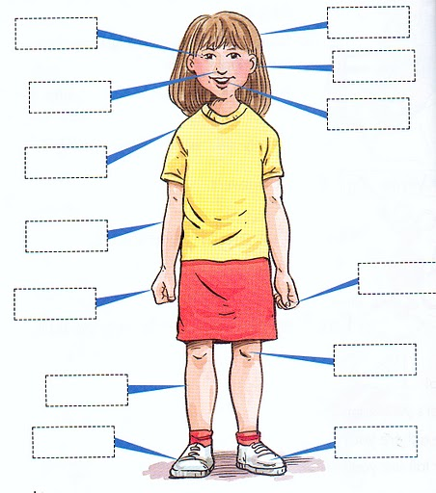
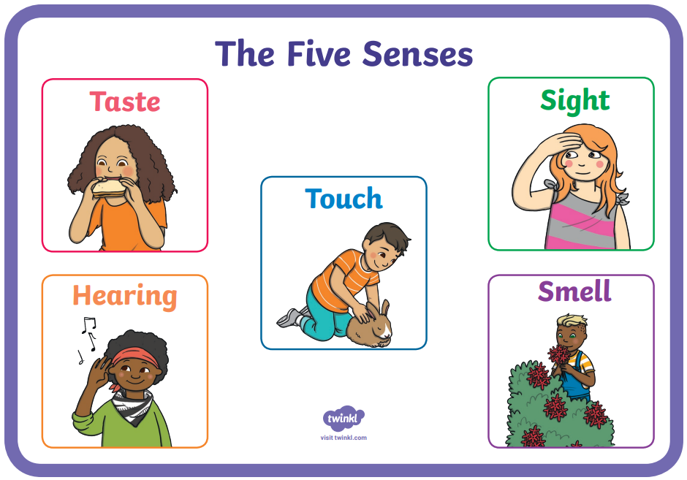


Science Fact Sheet - Humans
Key Vocabulary
Senses | Any of five ways (touch, smell, taste, sight, hearing) to understand or experience our surroundings.
Human Body | A system made up of cells, tissue and organs all working together to make a human being.
Touch | When objects or forces are perceived through the body (especially hands).
Smell | Receiving odours or scents through the organs in the nose.
Taste | The sensation of flavour received in the mouth.
Sight | The power of seeing.
Hear | The ability of perceiving sounds.
We will think about the different things our body does, why it is important and why we need to look after it.
There are five senses: touch, sight, smell, taste and hearing.
In this topic we will learn to identify and label different parts of the human body.
We will learn about the five senses and which body parts are associated with each sense.
We will also look at how all human bodies are different, and look at similarities and differences between each other.
We will look at the ways our body changes as we get older.

