Slide 1
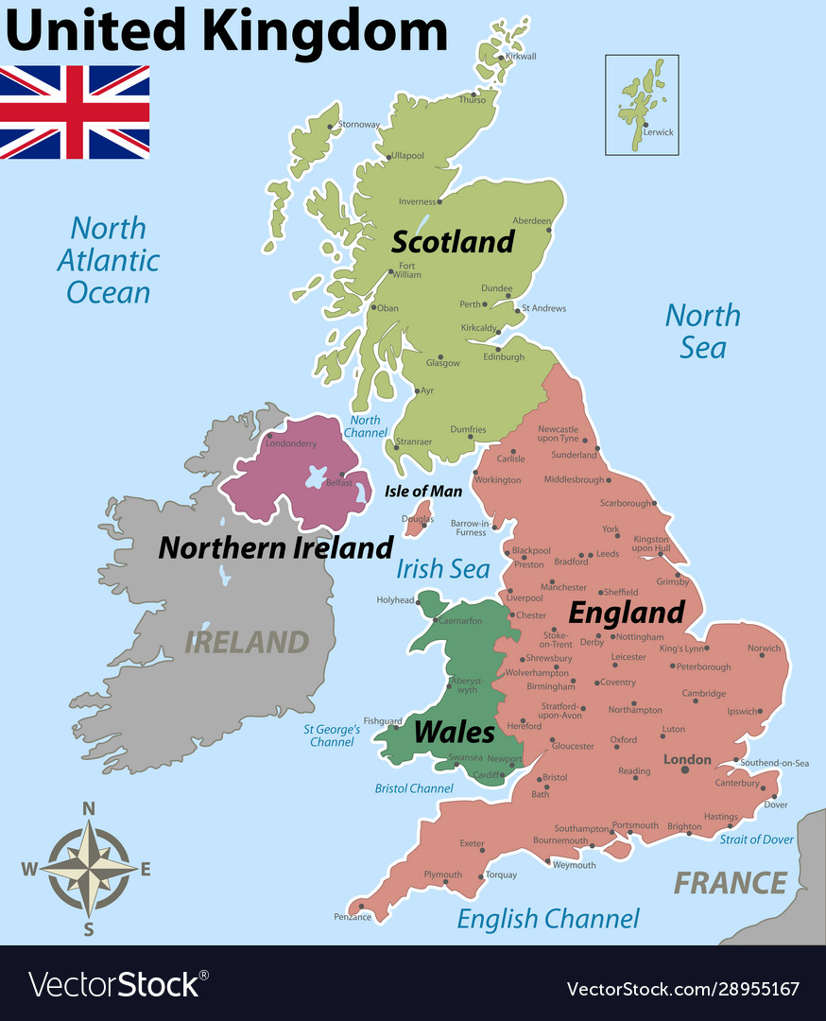
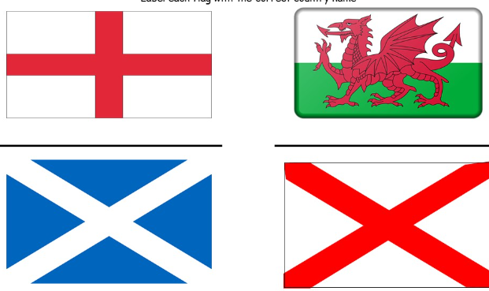
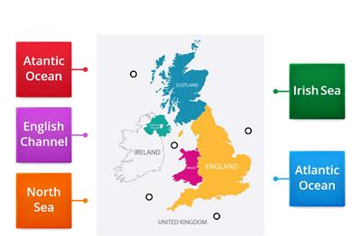
Geography Fact Sheet - Robots
Key Vocabulary
Capital City | The city where the government of a country, state, or province is located
Country | A large area of land where people live under the same government or have the same culture; nation
Location | A place or position
Physical Feature | The scientific study of the natural features of the Earth's surface
Human Feature | Something that can be man-made.
Landmark | an object or feature of a landscape or town that is easily seen and recognized from a distance.
Sea | An expanse of salt water
We will learn about the different flags of the countries that make up the United Kingdom.
We will identify human and physical features in the different UK countries and capitals.
In this topic we will learn to name, locate and identify characteristics of the four countries and capital cities of the United Kingdom and its surrounding seas.
We will look at some of the main characteristics and landmarks of the four UK countries and capital cities.
We will identify the different seas that surround the UK and locate them.
We will use maps and other images to talk about everyday life e.g. where we live etc

