Slide 1


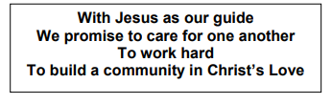
Welcome to EYFS

Slide 2
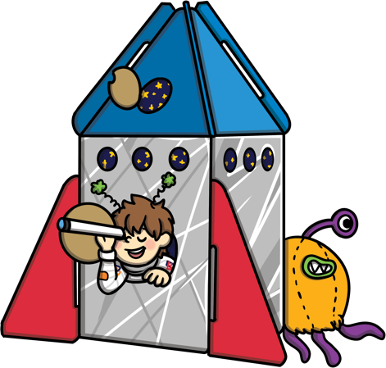
What Is the EYFS?
The Early Years Foundation Stage covers the first stage of a child’s care
from birth to five years old. It sets the standards to ensure that all children
learn and develop, as well as keeping them healthy and safe.
All schools and Ofsted registered early years providers in England must
follow the EYFS.
Also included in the EYFS are the seven Areas of Learning. They are:
  Communication and Language
  Personal, Social and Emotional Development
  Physical Development
  Literacy
  Mathematics
  Understanding the World
  Expressive Arts and Design
At the end of the EYFS, there are 17 Early Learning Goals that children are expected to achieve.

Slide 3
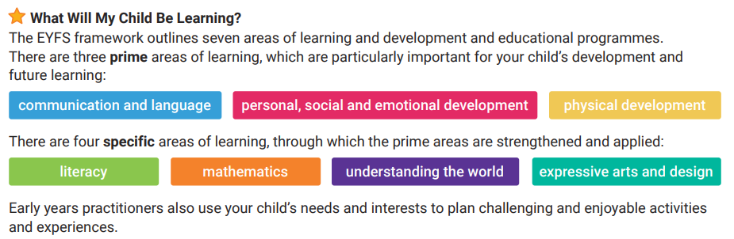
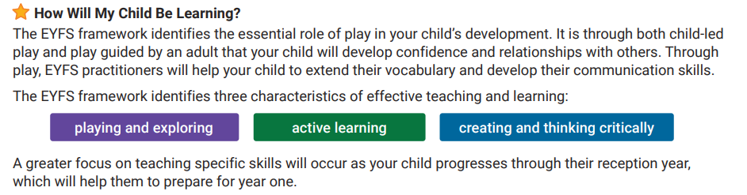

Slide 4
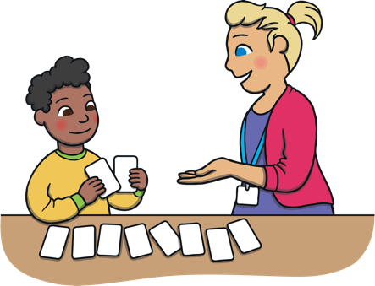
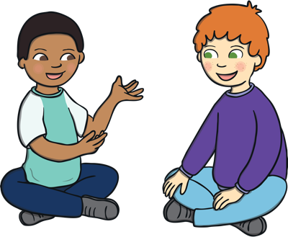
Communication and Language
There is a strong emphasis on the importance of developing communication and language skills.
Children should be supported in building up vocabulary by increasing the amount of words they know and can use.
Encourage more conversations between adults and children, but also children and their peers.
Good language skills are the basis for all other learning and social interaction, so this is vital to focus on.

Slide 5
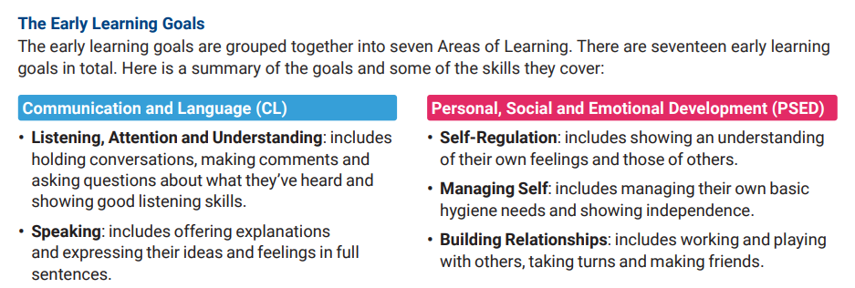
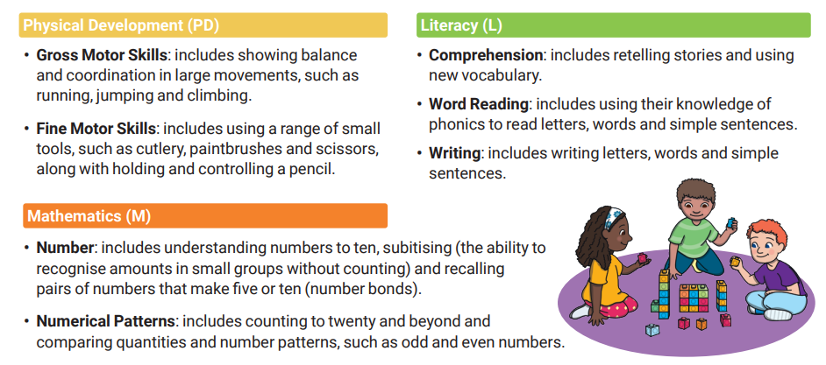

Slide 6
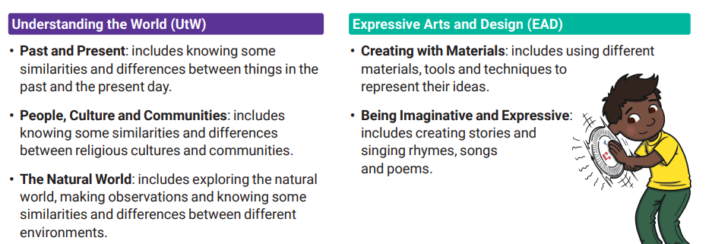

Slide 7
Communication
Appointments can be made to see us via the School Office – do speak to us with any concerns.
Class Dojo
Written Reports – July
Parent Evenings – October & February
Please feel free to come and speak to me at the end of the day.

Slide 8
Class Themes
Every half term we have a overarching topic that we base our learning around. This half term the topic is Myself. This helps us to get to know the children and helps them get to know us.
Each week our learning will have a ‘mini’ theme. Our learning activities and stories are linked to this. This week’s theme has been family. Thank you for all the wonderful family photos!
Next week we will be looking at school and friendships.

Slide 9
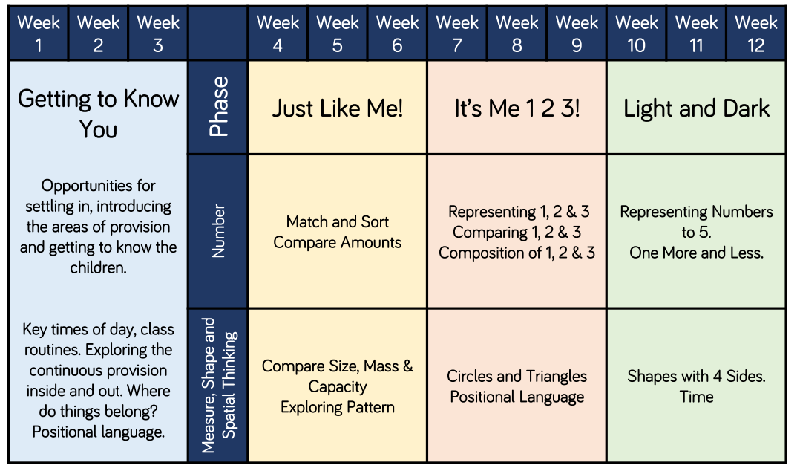
Maths
We use a scheme called White Rose as our guide which will help us focus on learning journeys and building next steps.

Slide 10

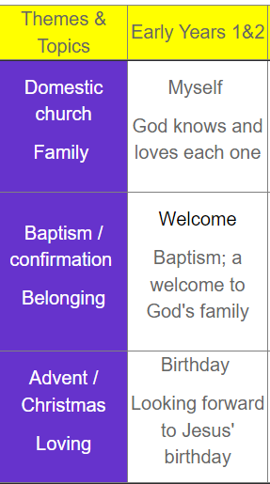
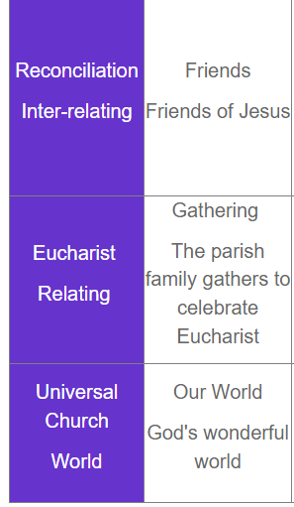
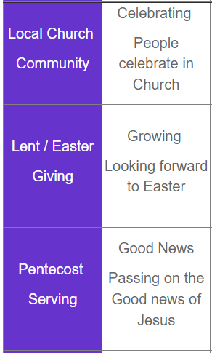
RE
We use a scheme called Come and See as our guide for our Religious Education. We also have weeks where we focus on learning about other religions.

Slide 11
School Uniform
Girls:
Grey/Navy pinafore or skirt, blue polo shirt with logo, school jumper or cardigan, white socks or navy/black tights and black shoes.
Boys:
Grey/Navy trousers, blue polo shirt with logo, school jumper, black socks and black shoes.
Winter uniform (after October half term) – blue shirt and school tie
Summer Term (After Easter holidays) - Girls may wear a blue summer dress.
Boys may also wear shorts in this term.
Hair should be tied up for school.
Book bags – normal book bags
Water in bottles

Slide 12
PE Uniform
Indoor Uniform | Outdoor Uniform
Navy/Black shorts White, round neck t-shirt Plimsolls / Trainers | Navy/Black leggings or jogging bottoms White, round neck t-shirt School jumper/cardigan
Children should not wear any jewellery when taking part in PE – this includes earrings.
Children who do not have the correct kit will be unable to participate fully in the lesson.
P.E will be on Thursday afternoon in EYFS – children are still coming into school in PE kits.

