Slide 1






Slide 2

A post office has 1,233 letters that need to be delivered but heavy snow means they cannot deliver any!
The next day, they receive another 787 letters.
The snow is a little better and they manage to deliver 546 letters.
How many letters are there left to deliver?
Have a think

Slide 3

A post office has 1,234 letters that need delivering.
The next day they receive another 787 letters to deliver.
They manage to deliver 546 of the letters.
2,021
Th | H | T | O
1 | 2 | 3 | 4
 | 7 | 8 | 7
Th | H | T | O
2 | 0 | 2 | 1
 | 5 | 4 | 6
9
1
1
1
1
1
546
+
Day 1
1,234
Day 2
787
$$−$$
2
0
2
1
1
4
7
5
There are 1,475 letters left to deliver.
1
1
1

Slide 4
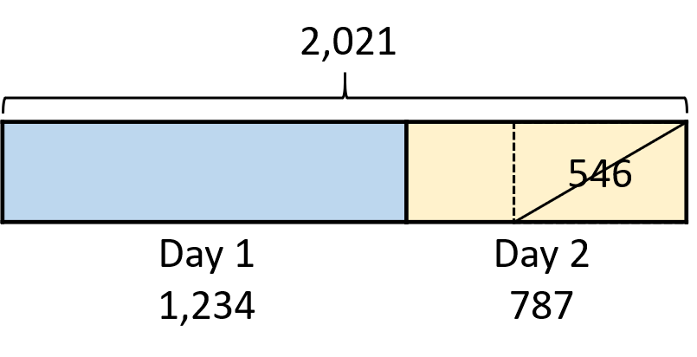
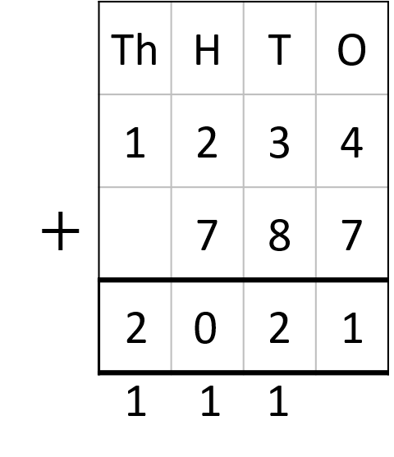



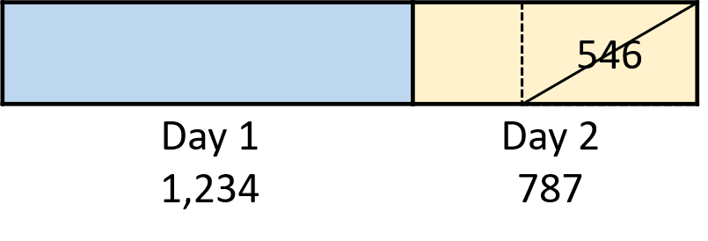
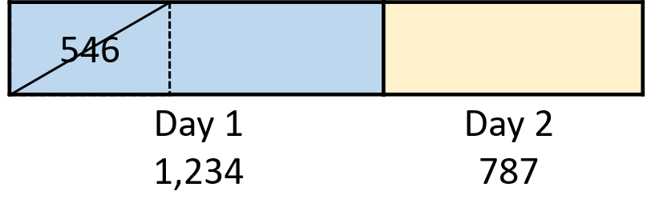


There are 1,475 letters left to deliver.

Slide 5



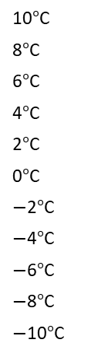

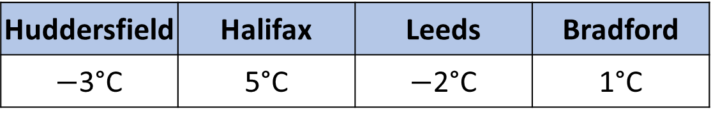
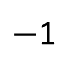
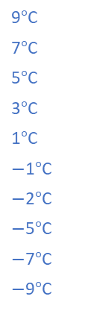

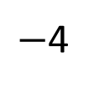
Here are the temperatures of four towns or cities.
It is only possible for snow to fall when the temperature is below 2°C.
In which places could it be snowing?
Huddersfield | Halifax | Leeds | Bradford
$−$3°C | 5°C | $−$2°C | 1°C
10$°$C
8$°$C
6$°$C
4$°$C
2$°$C
0$°$C
$−$2$°$C
$−$4$°$C
$−$6$°$C
$−$8$°$C
$−$10$°$C
9$°$C
7$°$C
5$°$C
3$°$C
1$°$C
$−$1$°$C
$−$2$°$C
$−$5$°$C
$−$7$°$C
$−$9$°$C
Huddersfield
Halifax
Leeds
Bradford
Have a think
$−$5
$−$4
$−$3
$−$2
$−$1
0
1
2
3
4
5

Slide 6

Here are the temperatures of four towns or cities.
What is the difference in temperature between these places?
Huddersfield and Bradford
Leeds and Huddersfield
Halifax and Leeds
Huddersfield | Halifax | Leeds | Bradford
$−$4°C | 5°C | $−$3°C | 1°C
Have a think

Slide 7
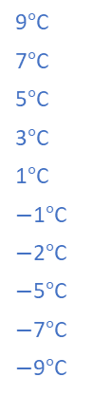

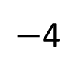
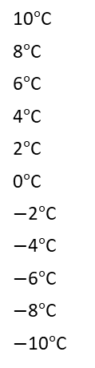



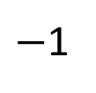
What is the difference in temperature between these places?
Huddersfield and Bradford
Leeds and Huddersfield
Halifax and Leeds
Huddersfield | Halifax | Leeds | Bradford
$−$4°C | 5°C | $−$3°C | 1°C
5°C
10$°$C
8$°$C
6$°$C
4$°$C
2$°$C
0$°$C
$−$2$°$C
$−$4$°$C
$−$6$°$C
$−$8$°$C
$−$10$°$C
9$°$C
7$°$C
5$°$C
3$°$C
1$°$C
$−$1$°$C
$−$2$°$C
$−$5$°$C
$−$7$°$C
$−$9$°$C
1°C
8°C
Huddersfield
3°C
Bradford
5°C
Leeds
Halifax
$−$5
$−$4
$−$3
$−$2
$−$1
0
1
2
3
4
5

Slide 8
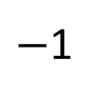
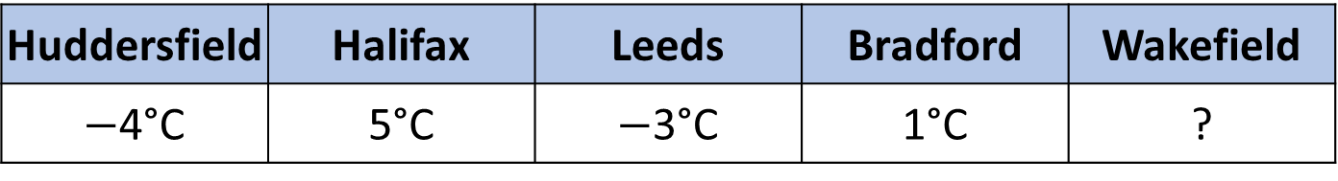

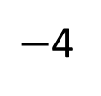


Here are the temperatures of four towns or cities.
Wakefield has the third warmest temperature.
What could the temperature be in Wakefield?
Huddersfield | Halifax | Leeds | Bradford | Wakefield
$−$4°C | 5°C | $−$3°C | 1°C | ?
Huddersfield | Halifax | Leeds | Bradford
$−$4°C | 5°C | $−$3°C | 1°C
1st
Huddersfield
2nd
Halifax
Leeds
Bradford
Have a think
$−$5
$−$4
$−$3
$−$2
$−$1
0
1
2
3
4
5

Slide 9

Rosie is posting 10 greetings cards.
She writes the house number on the front of each envelope.
Here are the house numbers.
1
4
5
9
10
13
32
35
38
39
Have a think
Rosie posts 2 cards every day for 5 days.
The sum of the house numbers on each day is shown in the table.
Mon | Tue | Wed | Thu | Fri
45 | 14 | 48 | 39 | 40
Which cards could Rosie post on each day?

Slide 10
1
4
5
9
10
13
32
35
38
39
Have a think
Mon | Tue | Wed | Thu | Fri
45 | 14 | 48 | 39 | 40
10 , 35
1 , 13
9 , 39
1 , 38
1 , 39
13 , 32
4 , 10
10 , 38
4 , 35
5 , 35
5 , 9
13 , 35
Which cards could Rosie post on each day?

Slide 11
1
4
5
9
10
13
32
35
38
39
Mon | Tue | Wed | Thu | Fri
45 | 14 | 48 | 39 | 40
10 , 35
1 , 13
9 , 39
1 , 38
1 , 39
13 , 32
4 , 10
10 , 38
4 , 35
5 , 35
5 , 9
13 , 35
Which cards could Rosie post on each day?

Slide 12
1
4
5
9
10
13
32
35
38
39
Mon | Tue | Wed | Thu | Fri
45 | 14 | 48 | 39 | 40
10 , 35
1 , 13
9 , 39
1 , 38
1 , 39
13 , 32
4 , 10
10 , 38
4 , 35
5 , 35
5 , 9
13 , 35
Which cards could Rosie post on each day?
Are there any other possible combinations?

