Slide 1
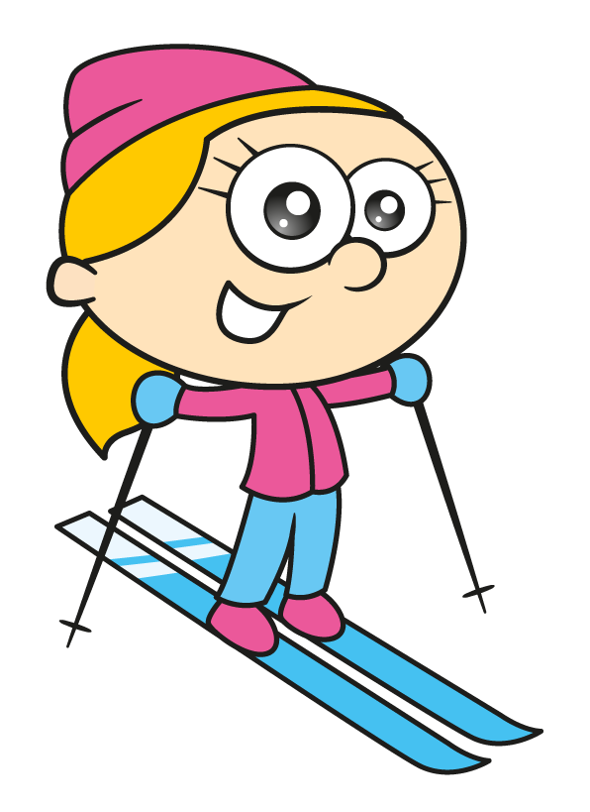
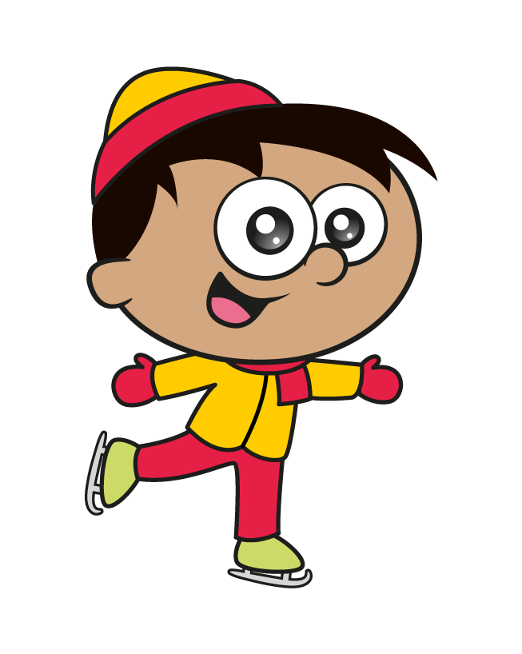
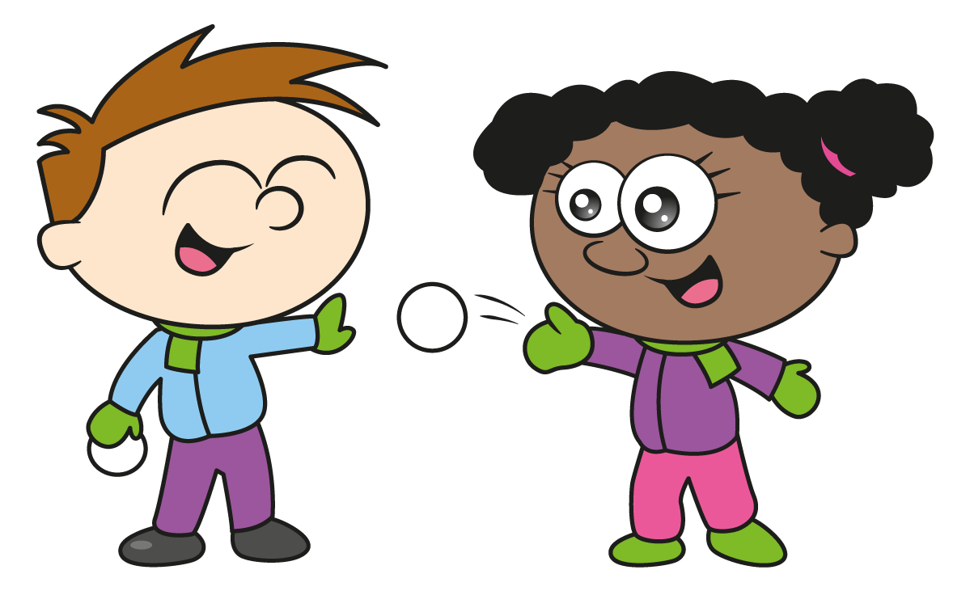
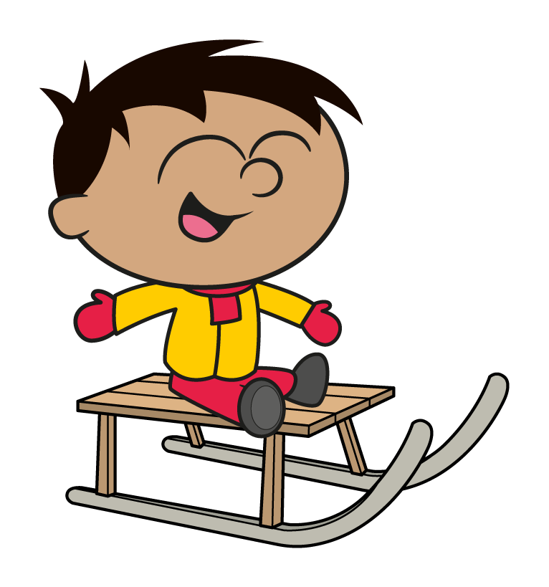

Slide 2
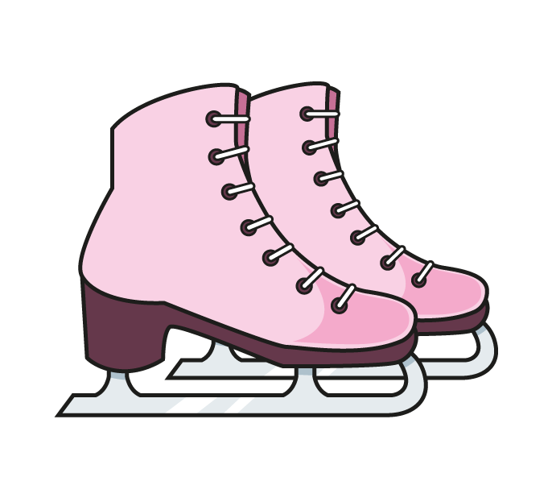
The children are taking part in an ice skating competition. What are their total scores?
Have a think
20
7
6
3
4
10
10
7
Double 7 $=$ 14
Bonds to 20

Slide 3
The children are taking part in an ice skating competition. What are their total scores?
Have a think
20
8
7
6
3
24
3 $×$ 7 $=$ 21
21 $+$ 3 $=$ 24

Slide 4
The children are taking part in an ice skating competition. What are their total scores?
Have a think
20
9
6
3
9
24
27
9

Slide 5
The children are taking part in an ice skating competition. What are their total scores?
Have a think
Can you place them in order to see who won?
20
9
5
8
4
24
8
13
5
27
13
16
$$+$$
10
26
Double 13 $=$ 26

Slide 6
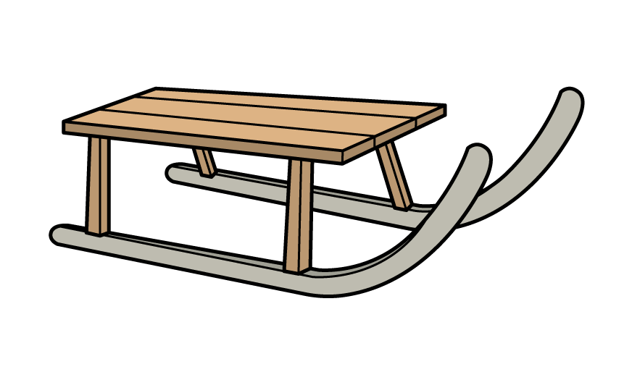
The children are relay racing down the hill in teams.
How many seconds slower were Teddy and Mo?
27 seconds
Have a think
38 seconds
43 seconds
41 seconds

Slide 7
How many seconds slower were Teddy and Mo?
27 seconds
43 seconds
38 seconds
41 seconds
T | O
2 | 7
3 | 8
T | O
4 | 3
4 | 1
19 seconds slower
T | O
8 | 4
6 | 5
?
7
65
1
27
38
+
+
$$−$$
84
43
41
6
8
1
5
4
9
1

Slide 8
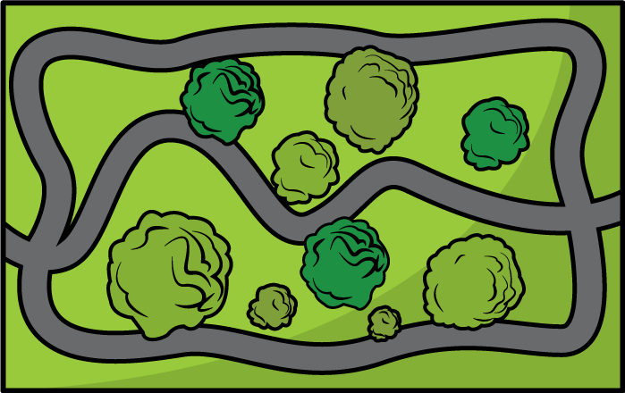
Ron is skiing around the park.
How far has he travelled in total?
2 km
Have a think
600 m
$\frac{\text{1}}{\text{2}}$ km
$\frac{\text{1}}{\text{2}}$ km
$\frac{\text{1}}{\text{2}}$ km
300 m
2 $\frac{\text{1}}{\text{2}}$ km

Slide 9
Ron is skiing around the park.
How far has he travelled in total?
2 km
Can you create a journey across the park that is less than 5 km?
2 km
1 km
$\frac{\text{1}}{\text{2}}$ km
$\frac{\text{1}}{\text{2}}$ km
3 km
600 m
4 km
600 m
Can you create a journey that is between 8 km
and 9 km?
$\frac{\text{1}}{\text{2}}$ km
$\frac{\text{1}}{\text{2}}$ km
$\frac{\text{1}}{\text{2}}$ km
$\frac{\text{1}}{\text{2}}$ km
6 km
300 m
300 m
6 km and 900 m
900 m
2 $\frac{\text{1}}{\text{2}}$ km
2 $\frac{\text{1}}{\text{2}}$ km

Slide 10
There are 36 children in Class 4
They are competing in their class Winter Olympics.
They need to be in equally sized teams.
How many children could be in each team?
Have a think

Slide 11
There are 36 children in Class 4
They are competing in their class Winter Olympics.
They need to be in equally sized teams.
How many children could be in each team?
2 teams of 18
2 $×$ 18
18 teams of 2
18 $×$ 2
What would happen if a child was off ill?
3 teams of 12
3 $×$ 12
12 teams of 3
12 $×$ 3
4 teams of 9
4 $×$ 9
9 teams of 4
9 $×$ 4
What would happen if an extra child joined the class?
6 teams of 6
6 $×$ 6

