Slide 1

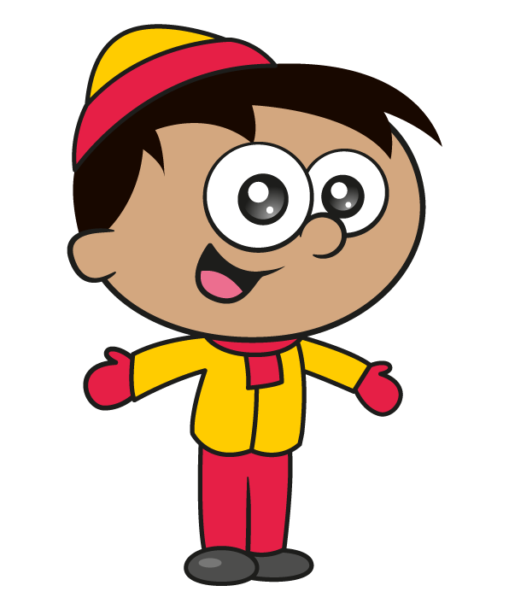
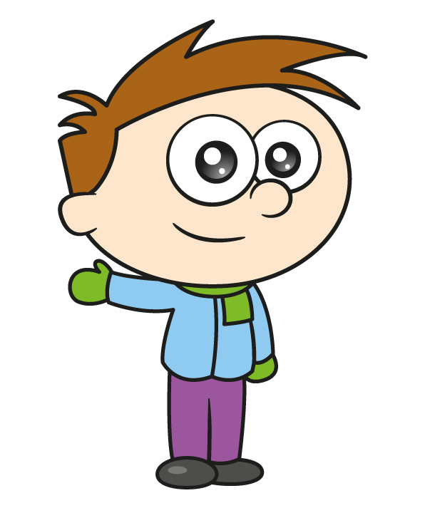
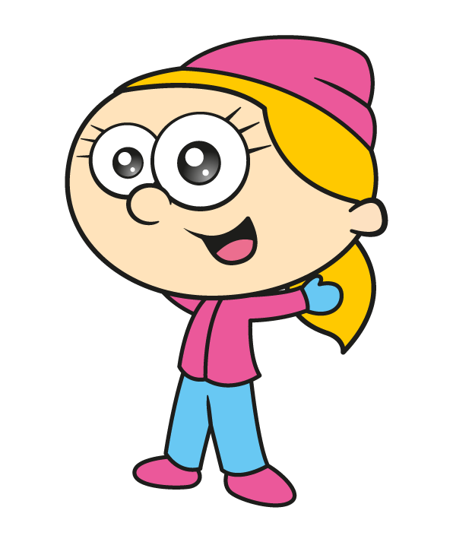
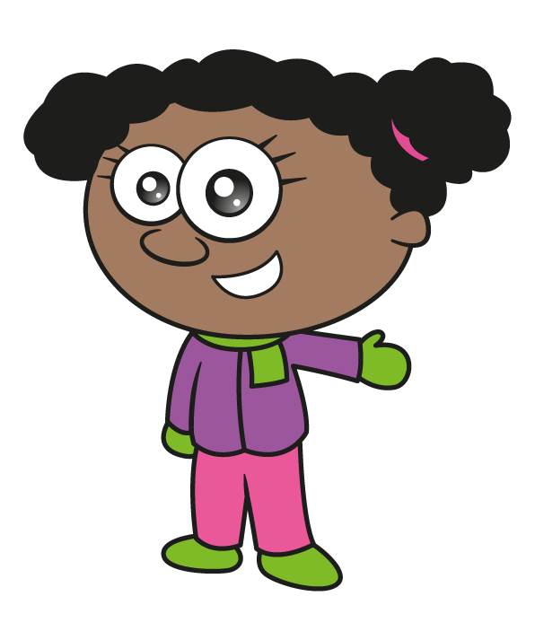

Slide 2

Mo has 4 coats. He wears them in the same order after they have been cleaned.
Have a think
Mo has 3 scarves. He wears them in the same order too.
On 1st December Mo wears his green coat and yellow scarf. When will he next wear them both together again?

Slide 3













On 1st December Mo wears his green coat and yellow scarf. When will he next wear them both together again?
1st Dec G $+$ Y
6th Dec O $+$ B
11th Dec B $+$ G
2nd Dec O $+$ G
7th Dec B $+$ Y
12th Dec R $+$ B
3rd Dec B $+$ B
8th Dec R $+$ G
13th Dec G $+$ Y
Will this happen again in December?
Do you notice any patterns?
What if Mo had 5 coats?
4th Dec R $+$ Y
9th Dec G $+$ B
5th Dec G $+$ G
10th Dec O $+$ Y

Slide 4
Whitney’s scarf is 980 mm long.
Ron’s scarf is 15 cm longer than Whitney’s.
What is the total length of both their scarves?
m and cm
Have a think

Slide 5
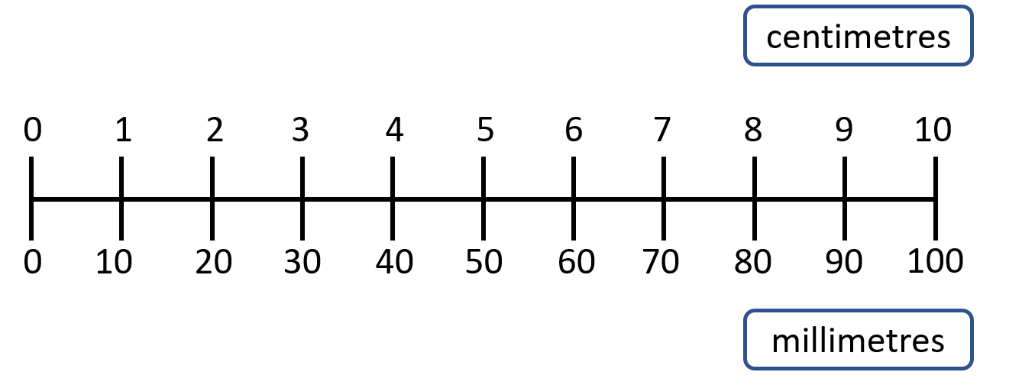
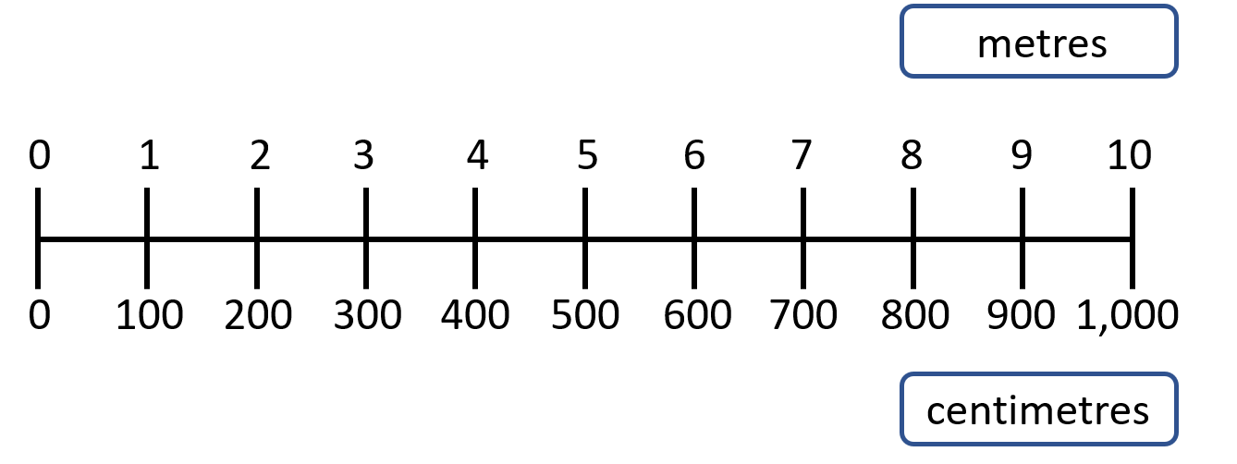


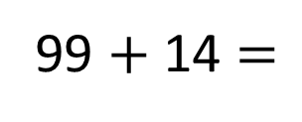
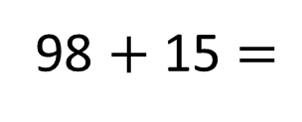
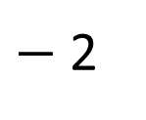

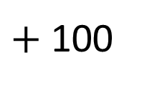


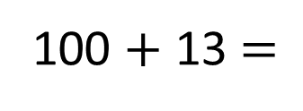
Whitney’s scarf is 980 mm long.
Ron’s scarf is 15 cm longer than Whitney’s.
What is the total length of both their scarves?
m and cm
2
11
T | O
9 | 8
1 | 5
$+$ 100
1 $+$ 6 $=$
98 $+$ 15 $=$
7
113
980 mm
15 cm
98 cm
99 $+$ 14 $=$
113
2 $+$ 5 $=$
7
$−$ 2
211 cm
?
+
100 $+$ 13 $=$
113
3 $+$ 4 $=$
7
113 cm
113
211
213

Slide 6
Class 4 are measuring the perimeter of their classroom to put decorations up.
1 m and 40 cm
Have a think
What is the perimeter of the classroom?
210 cm
2 m and 80 cm
1 m and 50 cm

Slide 7
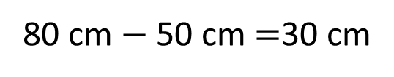
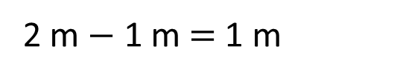
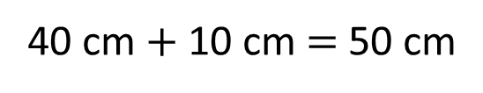
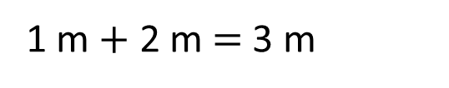
What is the perimeter of the classroom?
1 m and 40 cm
1 m $+$ 2 m $=$ 3 m
2 m $−$ 1 m $=$ 1 m
40 cm $+$ 10 cm $=$ 50 cm
1 m and 30 cm
80 cm $−$ 50 cm $=$30 cm
2 m and 10 cm
210 cm
2 m and 80 cm
1 m and 50 cm
3 m and 50 cm

Slide 8
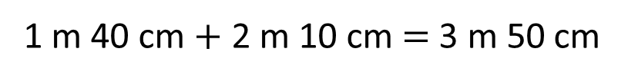
What is the perimeter of the classroom?
12 m 60 cm
1 m 40 cm $+$ 2 m 10 cm $=$ 3 m 50 cm
1 m and 40 cm
$+$ $=$
12 m 60 cm
7 m
1 m and 30 cm
2 m and 10 cm
2 m and 80 cm
1 m and 50 cm
4 m
and 160 cm
5 m and 60 cm
3 m and 50 cm

Slide 9


What is the perimeter of the classroom?
12 m 60 cm
I wonder how many of my scarves would fit around the perimeter of the classroom…
1 m and 40 cm
1 m and 30 cm
2 m and 10 cm
2 m and 80 cm
1 m and 50 cm
50 cm
Have a think
3 m and 50 cm

Slide 10
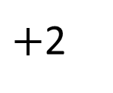
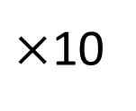
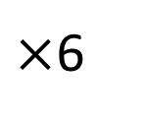
What is the perimeter of the classroom?
12 m 60 cm
I wonder how many of my scarves would fit around the perimeter of the classroom…
25 scarves
1
2
4
20
24
25
Scarves
Length
50 cm
50 cm
1 m
2 m
10 m
12 m
12 m 50 cm
$×$10
$×$6
$+$2

