Slide 1
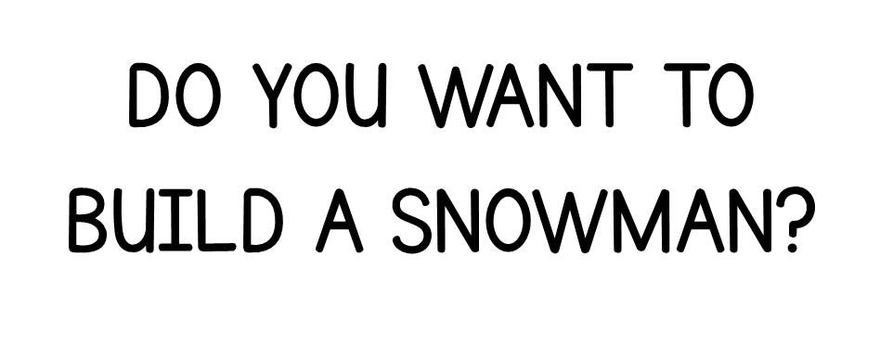
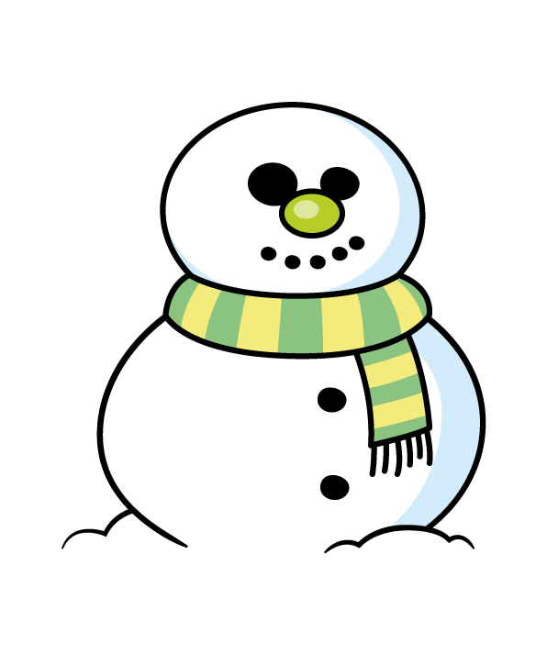

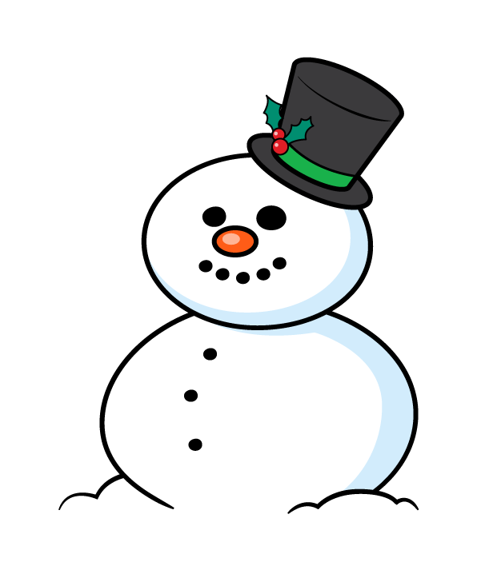



Slide 2

Snowman A
123cm
Snowman B
98 cm
Snowman C
132 cm
Snowman D
127 cm
Order the snowmen from shortest to tallest
Have a think

Slide 3
Snowman A
123cm
Snowman B
98 cm
Snowman C
132 cm
Snowman D
127 cm

Slide 4
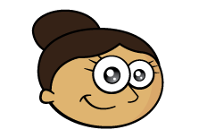
Dora builds another snowman that becomes the second tallest.
How tall could it be?
Have a think
128 cm
129 cm
130 cm
131 cm
Snowman B
98 cm
Snowman A
123 cm
Snowman D
127 cm
Snowman C
132 cm

Slide 5


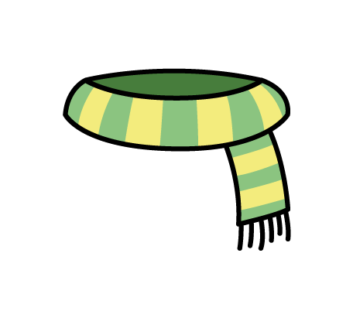
How many different ways could the snowman be dressed?
Have a think

Slide 6
How many different ways could the snowman be dressed?
Black/Yellow
Orange /Yellow
Blue/Yellow
Black/Grey
Orange /Grey
Blue/Grey
Black/Green
Orange /Green
Blue/Green
Black/Purple
Orange /Purple
Blue/Purple

Slide 7
45 cm
28 cm
22 cm
Eva’s Snowman
127 cm
Ron makes a snowman using the three snowballs.
How much taller is Eva’s snowman?
Have a think

Slide 8

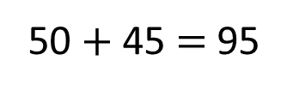
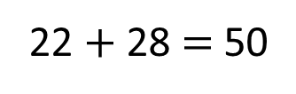
45 cm
28 cm
22 cm
Eva’s Snowman
127 cm
32 cm
H | T | O
1 | 2 | 7
 | 9 | 5
?
22 $+$ 28 $=$ 50
Ron
45 cm
95 cm
28 cm
22 cm
50 $+$ 45 $=$ 95
0
1
$$−$$
Eva
127 cm
3
2

Slide 9

Mo has 15 buttons.
Have a think
He uses all the buttons.
He puts an odd amount of buttons on each snowman.
Each snowman has a different amount of buttons.
How many different possible combinations are there?

Slide 10

What if Mo has 17 buttons?
What if there were 4 snowmen?
What if Mo used a combination of odd and even amounts?
Mo has 15 buttons.
1 | 3 | 11
1
5
9
1
3
7
9
5
7

